Slide 1
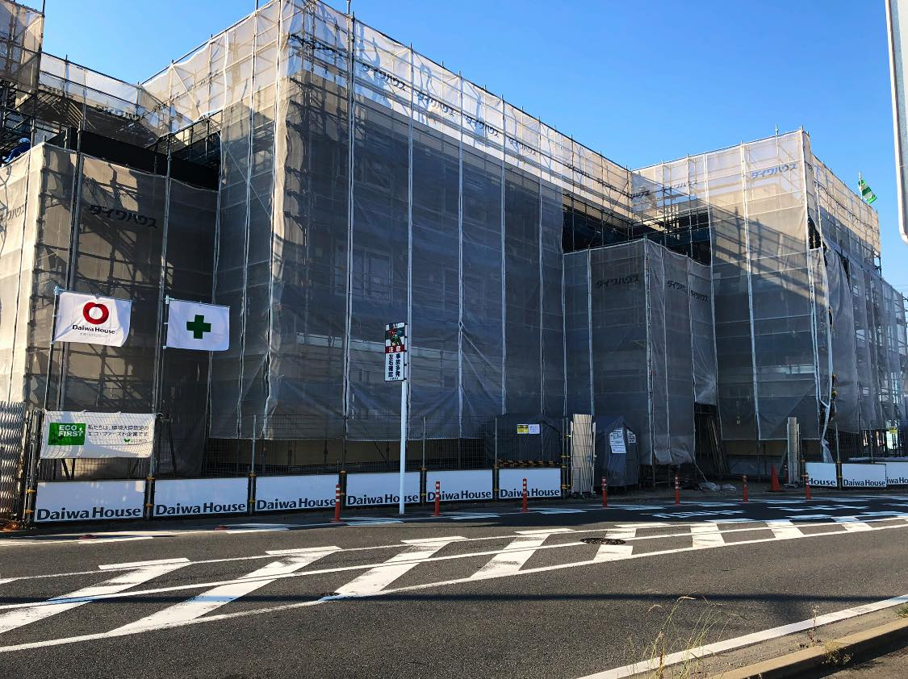
Jesly Villa
A Muslim friendly hotel

Slide 2
Introduction
Located in Kaneda, near Tokyo Bay Aqua line
20 minutes from Haneda International Airport
Free Shuttle Service to and from Haneda International Airport & Tokyo Shinagawa Station
Provide Rent A Car facilities
Prayer Room facilities available
Serve 100% Halal Malay – Indonesian cuisine
Convenient location

Slide 3
Types of Rooms
Family Rooms
Share Rooms
Suite Rooms

Slide 4
Family Rooms
From August 20th to October 31st
Maximum of 5 pax

Slide 5
Share Room
Maximum of 8 pax

Slide 6
Suite Room
J suite : 5 pax
Y suite : 7 pax

Slide 7
Rent A Car
Toyota Coaster
Toyota Velfire
Toyota Hiace Grand Cabin
Toyota Estima
Toyota Alphard
Toyota Vitz

Slide 8
Toyota Coaster
2019 Model
29 seater

Slide 9
Toyota Hiace Grand Cabin
10 Seater

Slide 10
Toyota Velfire
8 Seater

Slide 11
Membership Program
Membership Categories
- Samurai ¥100,000
- Fujisan ¥50,000
- Sakura ¥30,000
- Treasure Hunt ¥10,000
Entitled for a maximum of 20% discount
Valid for 3 ~ 5 years

Slide 12
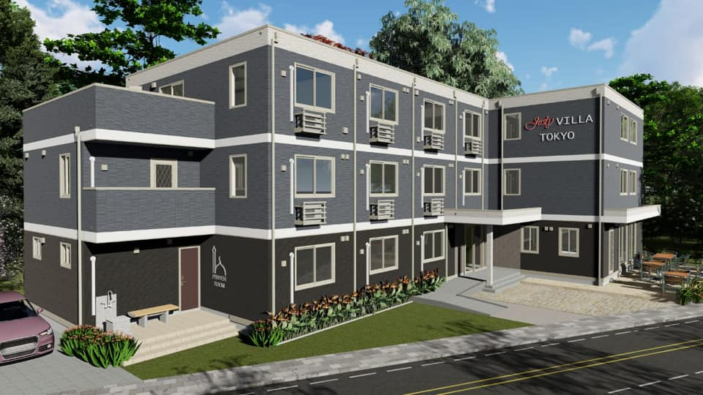
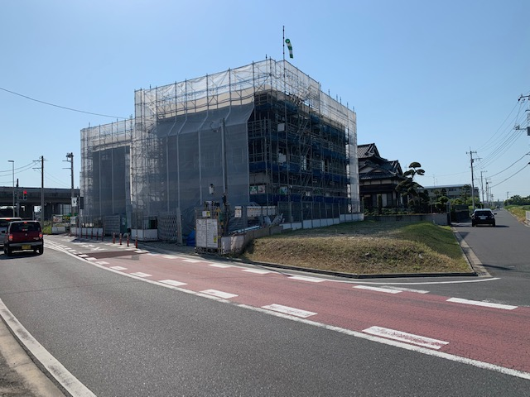

Slide 13
THANK YOU!

